Slide 1
Presented by
Ahmed Youssef Amin Badr
Supervised by
“AMIT”

Slide 2
Magic Methods

Slide 3
Magic or Dunder Methods
Magic methods in Python are the special methods that start and end with the double underscores. They are also called dunder methods. Magic methods are not meant to be invoked directly by you, but the invocation happens internally from the class on a certain action. For example, when you add two numbers using the + operator, internally, the __add__() method will be called.

Slide 4
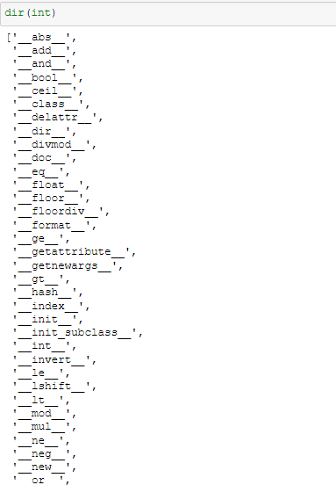
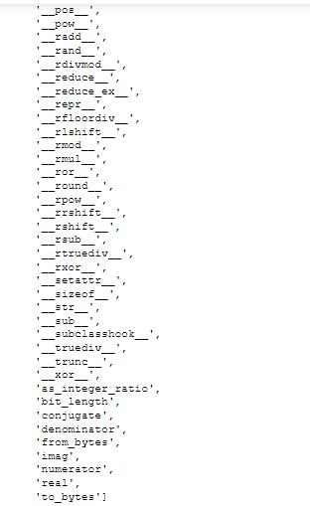
Built-in classes in Python define many magic methods. Use the dir() function to see the number of magic methods inherited by a class. For example, the following lists all the attributes and methods defined in the int class.

Slide 5
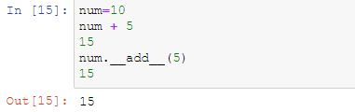
As you can see above, the int class includes various magic methods surrounded by double underscores. For example, the __add__ method is a magic method which gets called when we add two numbers using the + operator. Consider the following example.

Slide 6
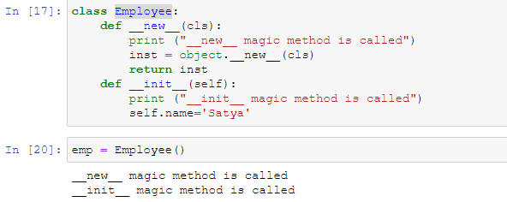
__new__()method
Languages such as Java and C# use the new operator to create a new instance of a class. In Python the __new__() magic method is implicitly called before the __init__() method. The __new__() method returns a new object, which is then initialized by __init__()

Slide 7
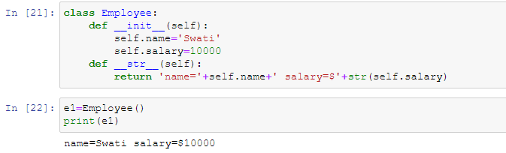
__str__() method
Another useful magic method is __str__(). It is overridden to return a printable string representation of any user defined class. We have seen str() built-in function which returns a string from the object parameter. For example, str(12) returns '12'. When invoked, it calls the __str__() method in the int class.

Slide 8
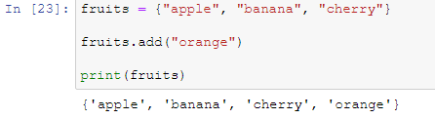
__add__() method
The set add() method adds a given element to a set if the element is not present in the set. Syntax: set. add(elem) The add() method doesn't add an element to the set if it's already present in it otherwise it will get added to the set.

Slide 9
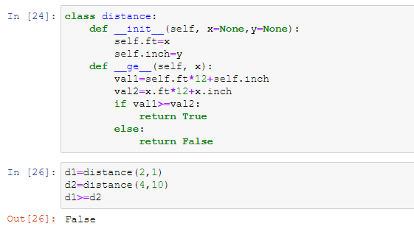
__ge__() method
This method gets invoked when the >= operator is used and returns True or False. Accordingly, the appropriate message can be displayed

Slide 10
Important Magic Methods

Slide 11
Initialization and Construction | Description
__new__(cls, other) | To get called in an object's instantiation.
__init__(self, other) | To get called by the __new__ method.
__del__(self) | Destructor method.
Augmented Assignment | Description
__iadd__(self, other) | To get called on addition with assignment e.g. a +=b.
__isub__(self, other) | To get called on subtraction with assignment e.g. a -=b.
__imul__(self, other) | To get called on multiplication with assignment e.g. a *=b.
__ifloordiv__(self, other) | To get called on integer division with assignment e.g. a //=b.
__idiv__(self, other) | To get called on division with assignment e.g. a /=b.
__itruediv__(self, other) | To get called on true division with assignment
__imod__(self, other) | To get called on modulo with assignment e.g. a%=b.
__ipow__(self, other) | To get called on exponentswith assignment e.g. a **=b.
__ilshift__(self, other) | To get called on left bitwise shift with assignment e.g. a<<=b.
__irshift__(self, other) | To get called on right bitwise shift with assignment e.g. a >>=b.
__iand__(self, other) | To get called on bitwise AND with assignment e.g. a&=b.
__ior__(self, other) | To get called on bitwise OR with assignment e.g. a|=b.
__ixor__(self, other) | To get called on bitwise XOR with assignment e.g. a ^=b.
Unary operators and functions | Description
__pos__(self) | To get called for unary positive e.g. +someobject.
__neg__(self) | To get called for unary negative e.g. -someobject.
__abs__(self) | To get called by built-in abs() function.
__invert__(self) | To get called for inversion using the ~ operator.
__round__(self,n) | To get called by built-in round() function.
__floor__(self) | To get called by built-in math.floor() function.
__ceil__(self) | To get called by built-in math.ceil() function.
__trunc__(self) | To get called by built-in math.trunc() function.

Slide 12
Type Conversion Magic Methods | Description
__int__(self) | To get called by built-int int() method to convert a type to an int.
__float__(self) | To get called by built-int float() method to convert a type to float.
__complex__(self) | To get called by built-int complex() method to convert a type to complex.
__oct__(self) | To get called by built-int oct() method to convert a type to octal.
__hex__(self) | To get called by built-int hex() method to convert a type to hexadecimal.
__index__(self) | To get called on type conversion to an int when the object is used in a slice expression.
__trunc__(self) | To get called from math.trunc() method.
String Magic Methods | Description
__str__(self) | To get called by built-int str() method to return a string representation of a type.
__repr__(self) | To get called by built-int repr() method to return a machine readable representation of a type.
__unicode__(self) | To get called by built-int unicode() method to return an unicode string of a type.
__format__(self, formatstr) | To get called by built-int string.format() method to return a new style of string.
__hash__(self) | To get called by built-int hash() method to return an integer.
__nonzero__(self) | To get called by built-int bool() method to return True or False.
__dir__(self) | To get called by built-int dir() method to return a list of attributes of a class.
__sizeof__(self) | To get called by built-int sys.getsizeof() method to return the size of an object.
Attribute Magic Methods | Description
__getattr__(self, name) | Is called when the accessing attribute of a class that does not exist.
__setattr__(self, name, value) | Is called when assigning a value to the attribute of a class.
__delattr__(self, name) | Is called when deleting an attribute of a class.

Slide 13
Operator Magic Methods | Description
__add__(self, other) | To get called on add operation using + operator
__sub__(self, other) | To get called on subtraction operation using - operator.
__mul__(self, other) | To get called on multiplication operation using * operator.
__floordiv__(self, other) | To get called on floor division operation using // operator.
__truediv__(self, other) | To get called on division operation using / operator.
__mod__(self, other) | To get called on modulo operation using % operator.
__pow__(self, other[, modulo]) | To get called on calculating the power using ** operator.
__lt__(self, other) | To get called on comparison using < operator.
__le__(self, other) | To get called on comparison using <= operator.
__eq__(self, other) | To get called on comparison using == operator.
__ne__(self, other) | To get called on comparison using != operator.
__ge__(self, other) | To get called on comparison using >= operator.

Slide 14
Thanks

